Slide 1
Properties of Stars

Slide 2
By the end of this lesson, you should be able to:
Describe the relationship between stellar wavelength and temperature using Planck curves.
Distinguish stars by their spectral classes.
Contrast apparent magnitude and absolute magnitude.

Slide 3
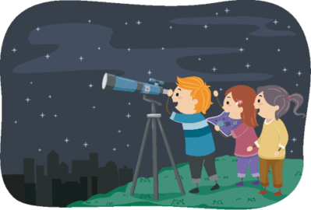
As studied in the last lesson, parallax is an effective way to measure the distance to stars by using triangulation.
But as the distances get larger, the angles involved become impossibly small to measure. This happens at around 30 pc (100 ly).
At this point, the parallax angle is around one ten-thousandth of a degree.

Slide 4
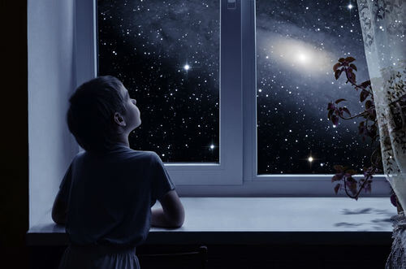
When you look at a star, what can you see?
The only information that a far-away star can provide is its light. Light has:
Brightness - The amount of light.
Colour - The frequency/wavelength of the light.
These are the two main properties of a star as seen from Earth. Both of these properties can provide us with the temperature of the star as well.

Slide 5
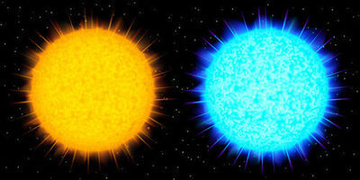
Every star emits electromagnetic radiation, much of which is in the visible light spectrum.
Because each star is different, different stars have different colours.
Additionally, some stars emit more light than others. We call the amount of light which we see the brightness.

Slide 6
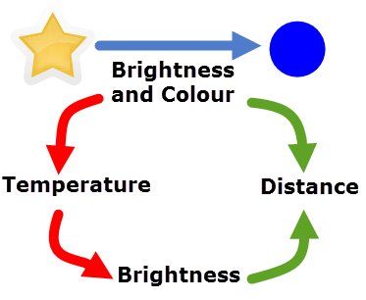
We can measure the colour and brightness of the star's light. The colour tells us the temperature. The temperature can then tell us how bright the star should be.
There is usually a difference between how bright the star should be and how bright the light we see is. We use this difference to find the distance.

Slide 7
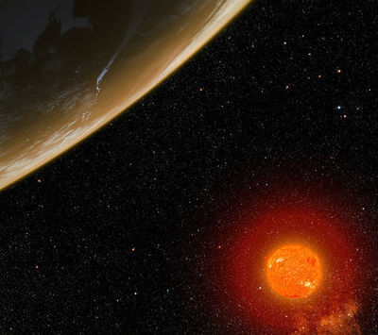
When metal is heated, it will begin to glow. First red, then yellow, then white and finally blue.
Stars have the same change in colour as their surface gets hotter.
So cooler stars emit energy in the infrared and red parts of the spectrum and hot stars emit in the blue, violet and ultraviolet parts.

Slide 8
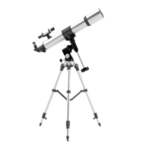
We can use a machine called a spectrometer to detect the wavelengths of a star's light.
Spectrometers split a light source into a spectrum of colours, and can detect which wavelength is the predominant colour.

Slide 9
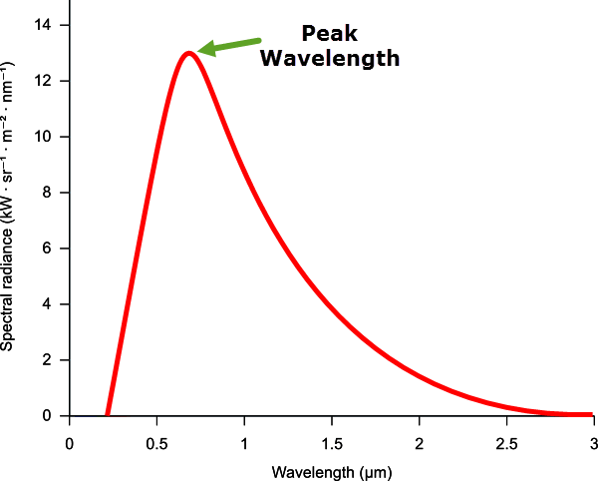
A hot object will emit light over a range of wavelengths which are at a range of intensities.
The pattern of wavelength to intensities takes the same form across most temperatures.
It takes the shape of a curve with a distinct maximum intensity wavelength or peak - this peak's wavelength is the main colour that you see when you look at the object.
This curve is called a Planck curve after Max Planck, who developed it.

Slide 10
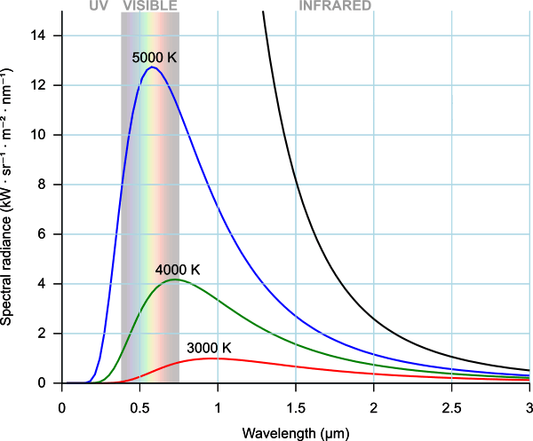
The hotter an object is, the more intense the peak is.
This graph shows how the Planck curve changes as you increase the temperature:
The temperature also shifts the peak to the left, towards lower wavelengths and more blue colours.
So if we can find the peak wavelength of a star, we can match it to a Planck curve to find the temperature!

Slide 11
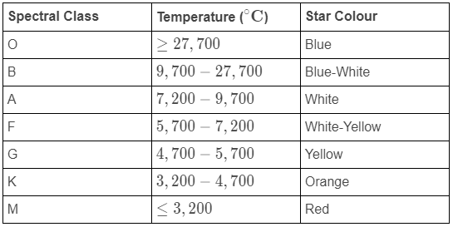
We classify stars based on their temperature and colour.
This classification system uses spectral classes as categories to place various stars into.
A star's spectral class tells us what temperature and colour a star is. Each has one letter to name the class. This table is below:

Slide 12
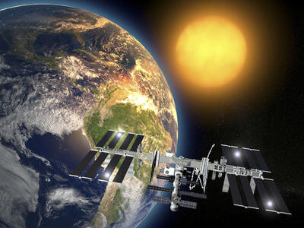
So for example, a B-type star will be blue-white in colour and have a temperature between 28,000°C and 10,000°C.
Our Sun falls into the G-type class, with a yellow colour and a surface temperature of 5700∘C.

Slide 13


Slide 14

We refer to the amount of light an object releases as its brightness.
Some objects are brighter than others - compare a computer screen to a light bulb, for example.
But if you have two light bulbs of the same brightness and they are different distances from you, the closer one is going to look brighter.
Brightness decreases with distance.

Slide 15

This becomes extremely relevant when the only information we have on distant stars is their colour and brightness.
Closer stars are often much brighter than those further away - for example, the Sun is brighter than any other star.

Slide 16

But we cannot base distance calculations solely on how bright the stars appear to be.
After all, Canopus is much brighter than Alpha Centauri, despite being about 75 times further from Earth.
This is because temperature also determines the brightness of stars.

Slide 17
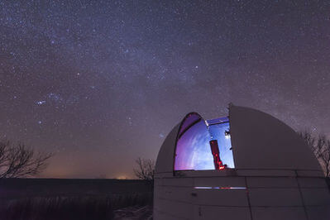
The brightness that we see from Earth is called the apparent magnitude.
The apparent magnitude is written m_{app}​.
We accurately measure the intensity value of the light from a star, and compare it to a standard object. This object is Vega, the fifth brightest star in the night sky.
Vega has an apparent magnitude value of 0. Brighter objects, like Sirius, the Sun and Venus, all have values in the negatives.
Less bright objects, like most of the other stars, have a positive value for apparent magnitude.

Slide 18
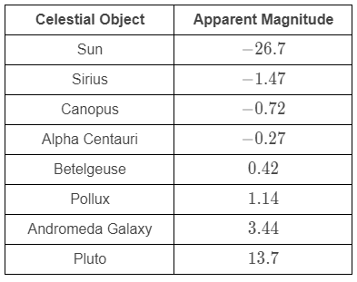
Here is a table of the apparent magnitude values of some celestial objects:

Slide 19
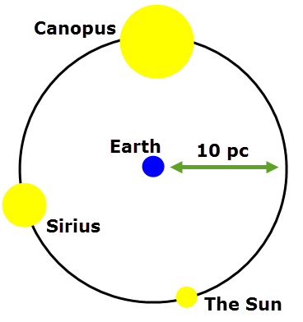
The values of apparent brightness only consider how bright the stars look.
But we would have a very different order of brightness if every star was the same distance from Earth.
Imagine we took the three brightest stars - The Sun, Sirius and Canopus - and moved them all to a distance 10 pc from Earth.
We now have a different order for brightness! Canopus is the brightest by far, followed by Sirius and then our Sun!

Slide 20

The way that brightness changes with distance is known and predictable, so we can calculate how bright every star would be at a distance of 10 pc from Earth.
Calculating the distance in this way of course only works for those stars which we know the distance to through parallax.
The brightness value at 10 pc is known as absolute magnitude, m_{abs}​.

Slide 21
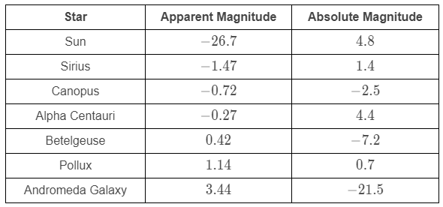
Here is a table showing how magnitudes change between apparent and absolute.
Note the Sun, which goes from being the brightest object in the sky to being not overly bright compared to many other stars.

